Slide 1

Civil aviation accidents
Shree Ramswaroop memorial university
Data analytics & reporting
Submitted to – Mrs. Deepika Tiwari
B.Tech cs(ds+ai) Group-37
Submitted by –
Avanish Yadav (202410101150187)
Aditya Singh Kushwaha (202410101150190)

Slide 2
Civil aviation accidents
CODE
Import pandas as pd
# Load your uploaded dataset
Df = pd.Read_csv('/content/drive/mydrive/aviation-accident.Csv')
# Show first few rows and info
Df.Head(), df.Info()
Required Materials : 1. .csv File of Aviation Accidents dataset
2. Google Collaboratory
import pandas as pd → Imports Pandas, a library used for data manipulation and analysis.
pd.read_csv() → Reads the dataset file (aviation-accident.csv) into a DataFrame named df.
df.head() → Displays the first 5 rows of the dataset.
df.info() → Displays summary info: column names, data types, and missing values.

Slide 3
Civil aviation accidents
DISPLAY
( date type registration operator fatalities \
0 date unk. Antonov An-12B T-1206 Indonesian AF NaN
1 date unk. Antonov An-12B T-1204 Indonesian AF NaN
2 date unk. Antonov An-12B T-1201 Indonesian AF NaN
3 date unk. Antonov An-12BK NaN Soviet AF NaN
4 date unk. Antonov An-12BP CCCP-11815 Soviet AF 0
location country cat year
0 NaN Unknown country U1 unknown
1 NaN Unknown country U1 unknown
2 NaN Unknown country U1 unknown
3 Tiksi Airport (IKS) Russia A1 unknown
4 Massawa Airport ... Eritrea A1 unknown ,
None)
df.head() - It will display the first 5 rows containing the data from the .CSV file.
df.info() - It will display summary information like date, registration, location, country, year.
This helps to understand the dataset before analysis.

Slide 4
Civil aviation accidents
# Core data analysis libraries
import pandas as pd
import numpy as np
# Visualization libraries
import matplotlib.pyplot as plt
import seaborn as sns
import plotly.express as px
# Statistical tools
from scipy.stats import linregress
# Display settings
pd.set_option('display.max_columns', None)
sns.set(style="whitegrid")
CODE
We will Import libraries for-
pandas / numpy → Data handling
matplotlib, seaborn, plotly.express → Graphs and charts
scipy.stats.linregress → Linear regression (trend analysis)
pd.set_option('display.max_columns', None) → Ensures all columns are visible in output.
sns.set(style="whitegrid") → Makes Seaborn plots look cleaner with a white grid.
It will set up all the tools needed for visual and statistical analysis.

Slide 5
Civil aviation accidents
CODE
# Load the uploaded CSV file
df = pd.read_csv('/content/drive/MyDrive/aviation-accident.csv')
# Preview first 5 rows
df.head()
We will again import the file and preview first 5 rows.

Slide 6
Civil aviation accidents
DISPLAY
# Load the uploaded CSV file
df = pd.read_csv('/content/drive/MyDrive/aviation-accident.csv')
# Preview first 5 rows
df.head()
It will display the first 5 rows.
date | type | registration | operator | fatalities | location | country | cat | year
0 | date unk. | Antonov An-12B | T-1206 | Indonesian AF | NaN | NaN | Unknown country | U1 | unknown
1 | date unk. | Antonov An-12B | T-1204 | Indonesian AF | NaN | NaN | Unknown country | U1 | unknown
2 | date unk. | Antonov An-12B | T-1201 | Indonesian AF | NaN | NaN | Unknown country | U1 | unknown
3 | date unk. | Antonov An-12BK | NaN | Soviet AF | NaN | Tiksi Airport (IKS) | Russia | A1 | unknown
4 | date unk. | Antonov An-12BP | CCCP-11815 | Soviet AF | 0 | Massawa Airport ... | Eritrea | A1 | unknown

Slide 7
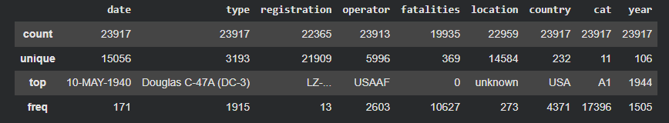
Civil aviation accidents
CODE
print("Dataset shape:", df.shape)
df.info()
df.describe(include='all')
It will make us understand data structure, completeness, and column statistics before cleaning.
df.shape → Returns total rows and columns (e.g., 10000×12).
df.info() → Lists column names, data types, and missing values.
df.describe(include='all') → Gives statistical summary (mean, median, unique counts, etc.) for all columns.
DISPLAY

Slide 8
Civil aviation accidents
CODE
df.replace('unknown', np.nan, inplace=True)
df['fatalities'] = pd.to_numeric(df['fatalities'], errors='coerce')
df['year'] = pd.to_numeric(df['year'], errors='coerce')
df = df.dropna(subset=['year', 'fatalities'])
df['year'] = df['year'].astype(int)
df.info()
DATA CLEANING
DISPLAY
Data columns (total 9 columns):
# Column Non-Null Count Dtype
--- ------ -------------- -----
0 date 19558 non-null object
1 type 19525 non-null object
2 registration 18289 non-null object
3 operator 19555 non-null object
4 fatalities 19558 non-null float64
5 location 19361 non-null object
6 country 19558 non-null object
7 cat 19558 non-null object
8 year 19558 non-null int64
dtypes: float64(1), int64(1), object(7)
4. It will Convert year to integer type.
5. It will Display cleaned dataset info.
1. It will Replace 'unknown' values with NaN
(so Pandas can detect them as missing).
2. It will Convert text columns (fatalities, year) into numeric types.
3. It will Drop rows with missing year or fatalities (incomplete records).

Slide 9
Civil aviation accidents
CODE
ACCIDENT PER YEAR
plt.figure(figsize=(12,6))
plt.plot(accidents_per_year, color='#0077b6', linewidth=2.5)
plt.fill_between(accidents_per_year.index, accidents_per_year, color='#90e0ef', alpha=0.3)
plt.title('Number of Aviation Accidents per Year', fontsize=16)
plt.xlabel('Year')
plt.ylabel('Accidents')
plt.grid(alpha=0.3)
plt.show()
It Creates a line chart showing total accidents by year.
It Uses a filled blue color tone for smooth visuals.
It also Adds labels and gridlines.
It visualize trends over time — how accident frequency changes year by year.

Slide 10
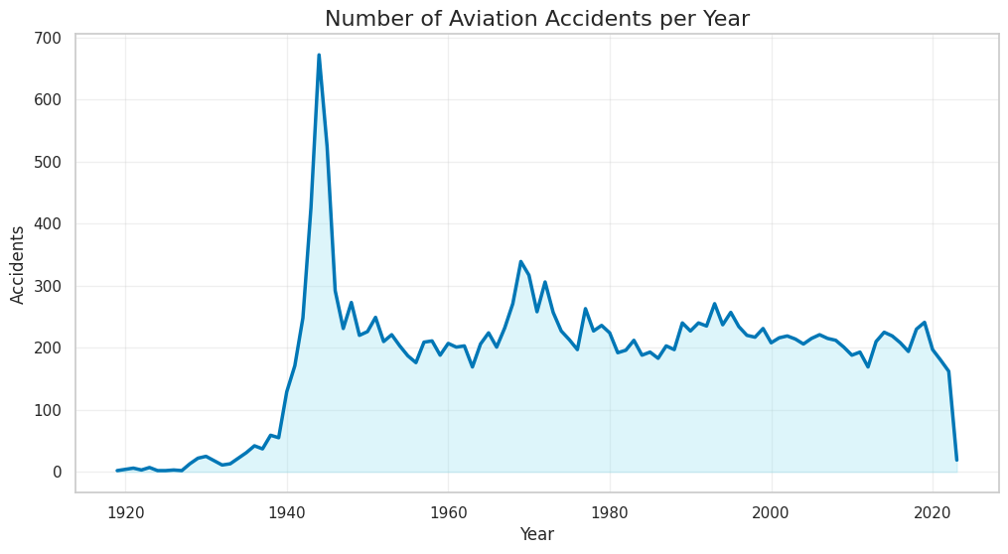
Civil aviation accidents
DISPLAY
ACCIDENT PER YEAR
Highest death from aviation goes in between 1940-1950 at the peak of 650 deaths.

Slide 11
Civil aviation accidents
CODE
df['year'] = pd.to_numeric(df['year'], errors='coerce')
df['fatalities'] = pd.to_numeric(df['fatalities'], errors='coerce')
df_clean = df.dropna(subset=['year', 'fatalities'])
fatalities_per_year = df_clean.groupby('year')['fatalities'].sum()
sns.set_style("whitegrid")
plt.figure(figsize=(12,6))
plt.bar(fatalities_per_year.index,
fatalities_per_year.values,
color=plt.cm.magma(fatalities_per_year.values / max(fatalities_per_year.values)))
plt.title('Total Fatalities per Year', fontsize=16)
plt.xlabel('Year')
plt.ylabel('Fatalities')
plt.show()
FATALITIES PER YEAR
It Groups data by year and sums up fatalities.
It Uses a bar chart with gradient colors (magma palette).
It Shows which years had the most deaths

Slide 12
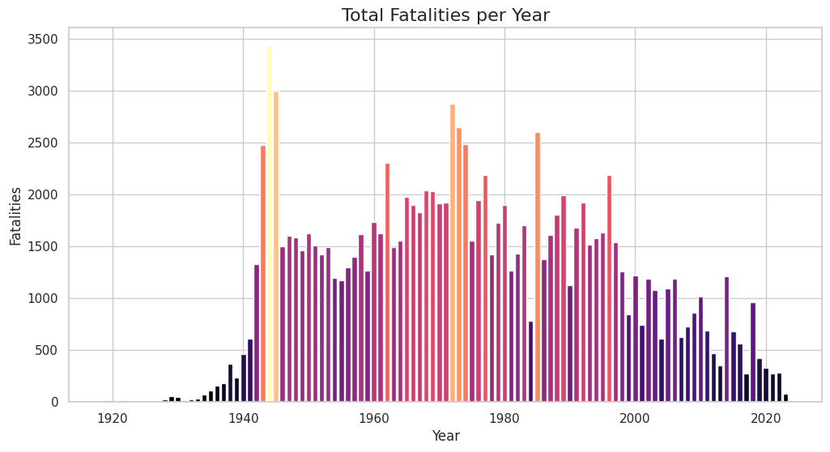
Civil aviation accidents
DISPLAY
FATALITIES PER YEAR
It detect spikes in fatalities
and identify the most tragic
years in aviation history
Highest fatalities goes in between Year 1940-1960 at the peak 3400

Slide 13
Civil aviation accidents
CODE
Top 10 Operators with Most Accidents
top_operators = df['operator'].value_counts().head(10)
print(top_operators)
sns.barplot(x=top_operators.values, y=top_operators.index, palette="crest")
plt.title("Top 10 Operators by Number of Accidents", fontsize=15)
plt.xlabel("Number of Accidents")
plt.ylabel("Operator")
plt.show()
It Counts accidents per airline/operator.
It Selects top 10 operators.
It Displays results in a horizontal bar chart using Seaborn.
operator
USAF 929
USAAF 845
RAF 710
US Navy 493
private 280
German AF 266
Aeroflot 183
Unknown 146
Air France 122
Soviet AF 119
DISPLAY
Highest Accidents are caused by
USAF airlines at peak 929.

Slide 14
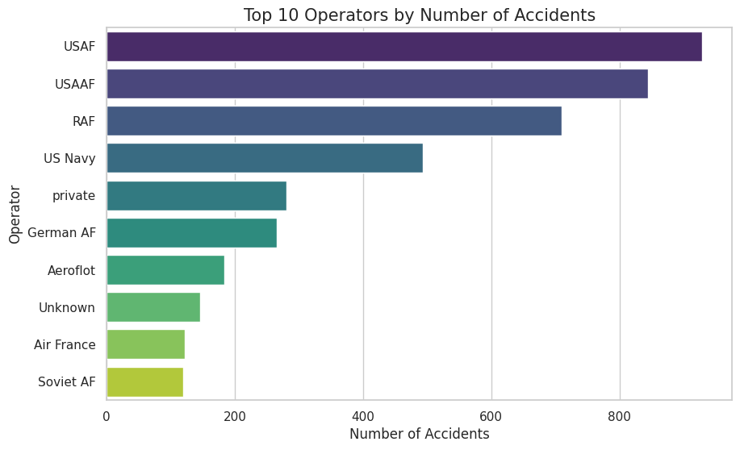
Civil aviation accidents
DISPLAY
Top 10 Operators with Most Accidents
Highest Accidents are
caused by
USAF airlines at peak 929.

Slide 15
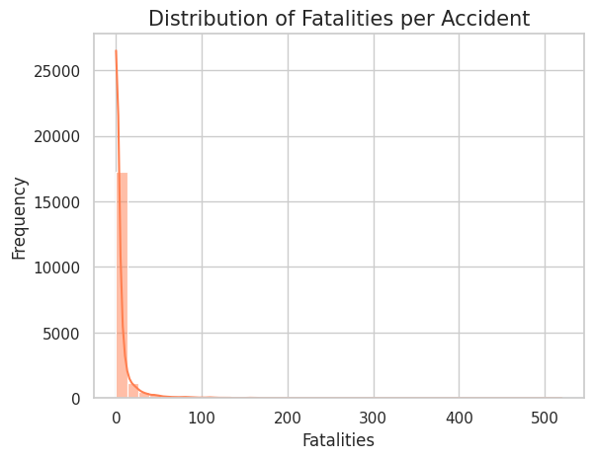
Civil aviation accidents
CODE
HISTOGRAM OF FATALITIES PER ACCIDENT
sns.histplot(df['fatalities'], bins=40, color='#ff7f50', kde=True)
plt.title('Distribution of Fatalities per Accident', fontsize=15)
plt.xlabel('Fatalities')
plt.ylabel('Frequency')
plt.show()
DISPLAY
It Creates a histogram to show how fatalities are distributed.
The KDE (Kernel Density Estimate) line smooths
the distribution curve.
It makes us understand whether
most accidents cause few or many deaths.

Slide 16
Civil aviation accidents
CODE
3D SCATTER PLOT (PLOTLY)
fig = px.scatter_3d(df,
x='year',
y='fatalities',
z='type',
color='fatalities',
size='fatalities',
color_continuous_scale='viridis',
title='3D Visualization: Year vs Fatalities vs Aircraft Type')
fig.show()
It Uses Plotly’s interactive 3D scatter plot.
It Plots year (x-axis), fatalities (y-axis), and type (z-axis).
The Color and bubble size represent number of fatalities.

Slide 17
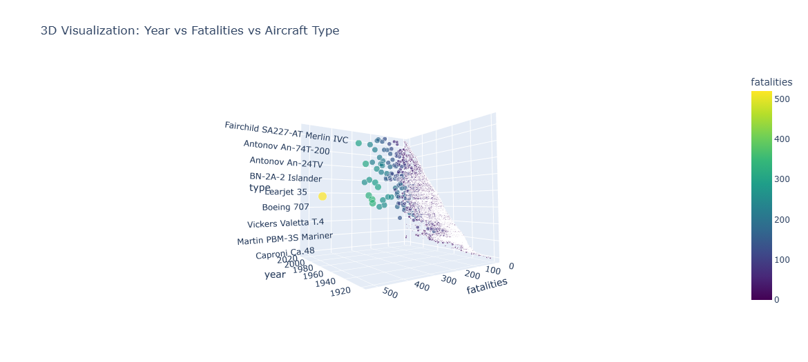
Civil aviation accidents
DISPLAY
3D SCATTER PLOT (PLOTLY)
It explore multi-dimensional relationships — how aircraft types and years affect fatality levels.

Slide 18
Civil aviation accidents
df['year'] = pd.to_numeric(df['year'], errors='coerce')
df['fatalities'] = pd.to_numeric(df['fatalities'], errors='coerce')
df_clean = df.dropna(subset=['year', 'fatalities'])
yearly = df_clean.groupby('year', as_index=False)['fatalities'].sum()
fig = px.line(yearly,
x='year',
y='fatalities',
markers=True,
title='Interactive Fatalities Trend (Plotly)',
color_discrete_sequence=['#ff4d6d'])
fig.update_traces(line=dict(width=3))
fig.update_layout(template='plotly_white')
fig.show()
INTERACTIVE LINE CHART (PLOTLY)
It Groups and sums fatalities by year.
It Plots an interactive line chart with hover details.
It Uses a modern pink-red tone and clean white theme.
CODE

Slide 19
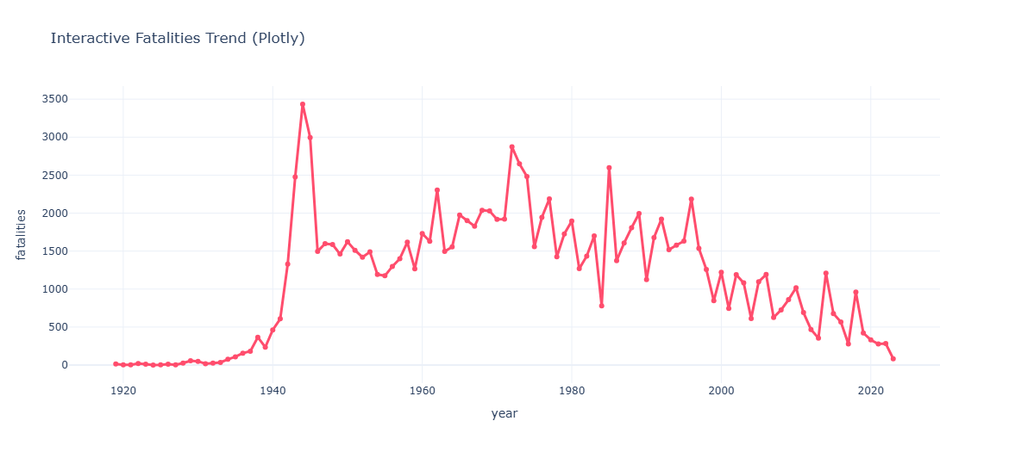
Civil aviation accidents
DISPLAY
INTERACTIVE LINE CHART (PLOTLY)
Year 1944 records highest fatalities (3434).

Slide 20
Civil aviation accidents
CODE
DESCRIPTIVE STATISTICS
mean_fatalities = np.mean(df['fatalities'])
median_fatalities = np.median(df['fatalities'])
std_fatalities = np.std(df['fatalities'])
print(f"Mean Fatalities: {mean_fatalities:.2f}")
print(f"Median Fatalities: {median_fatalities}")
print(f"Standard Deviation: {std_fatalities:.2f}")
It Calculates Mean, Median, and Standard Deviation of fatalities.
It Provides central tendency and variability.
It summarizes the average scale and spread of fatal accidents in one glance.
Mean Fatalities: 6.17
Median Fatalities: 0.0
Standard Deviation: 18.74
DISPLAY

